Slide 1
Watermarking

Slide 2
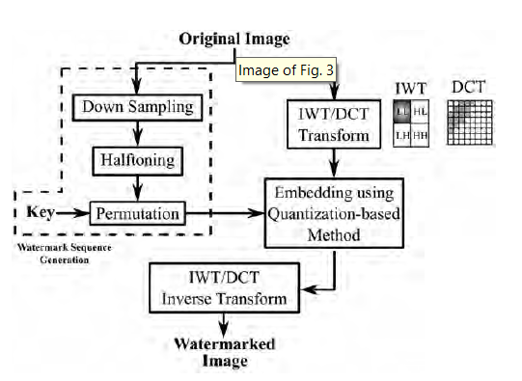
Embedding Stage

Slide 3
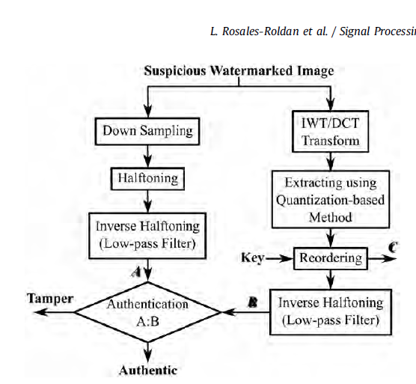
Authentication Stage

Slide 4
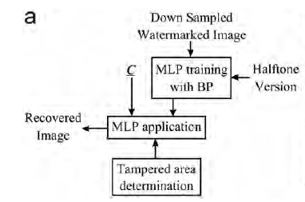
Recovery Process

Slide 5
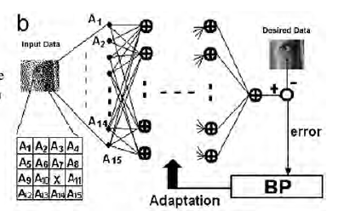

Slide 6
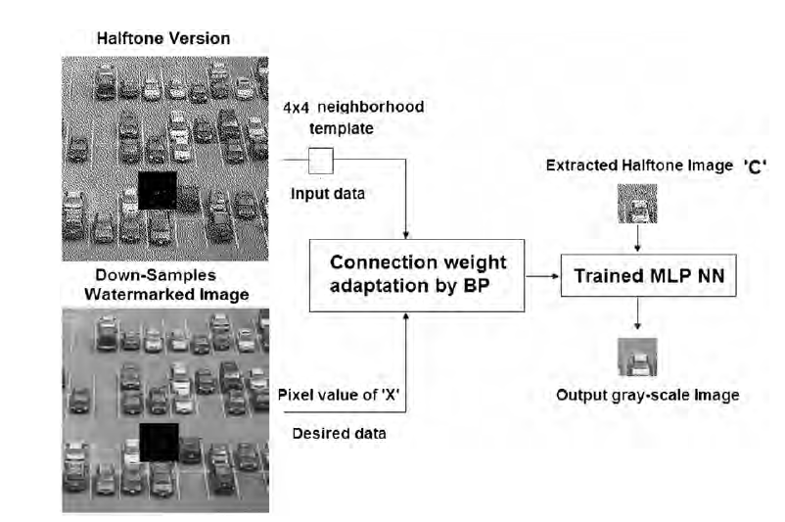

Slide 7
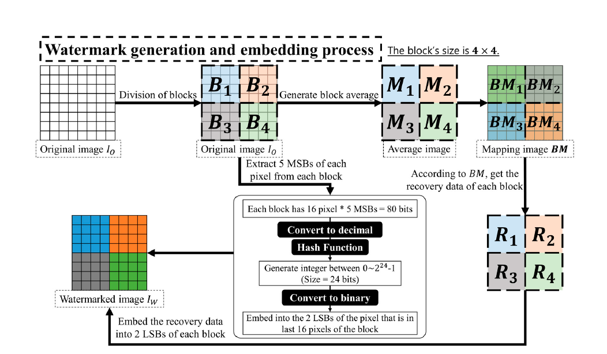
Watermark Generation(block-wise)

Slide 8
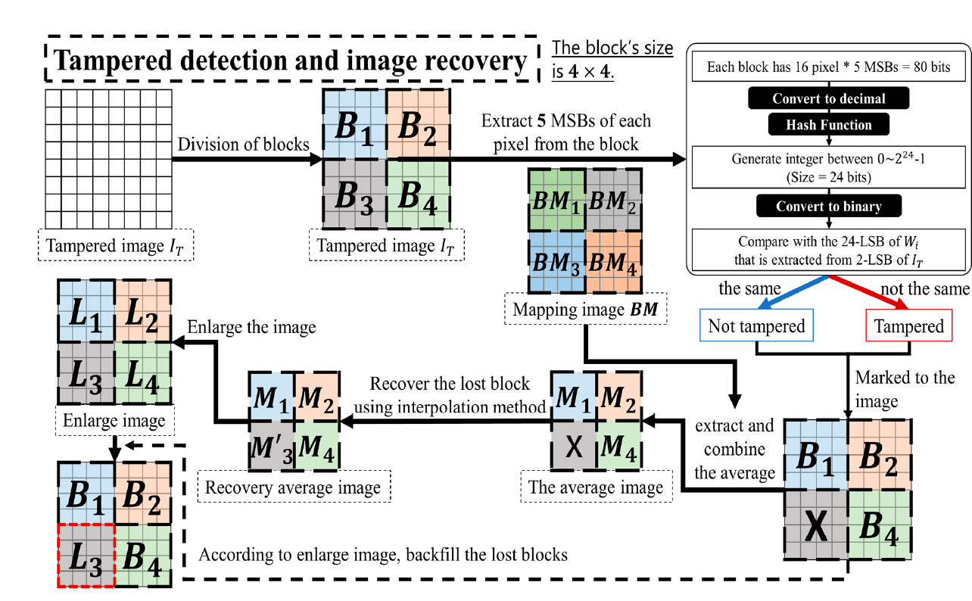
Tamper Detection and Recovery(block-wise)

Slide 9
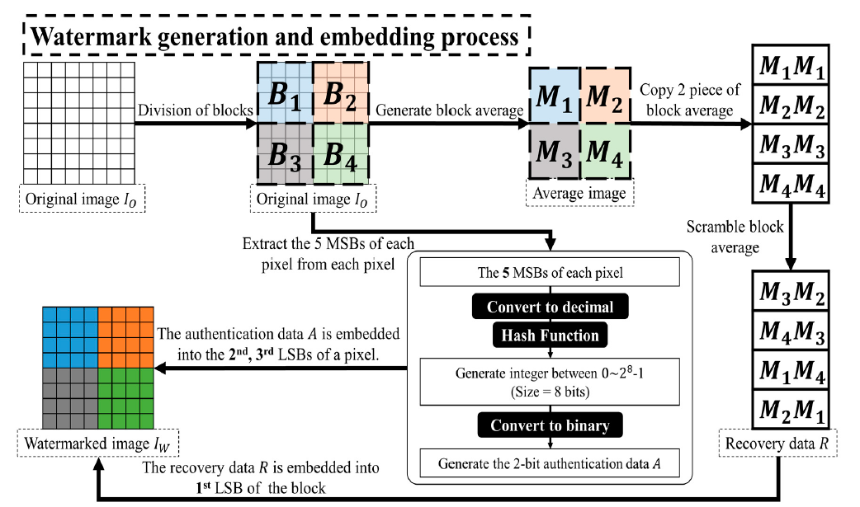
Watermark Generation(pixel-wise)

Slide 10
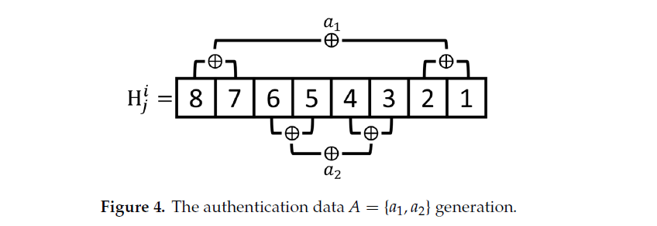
Authentication Data Generation

Slide 11
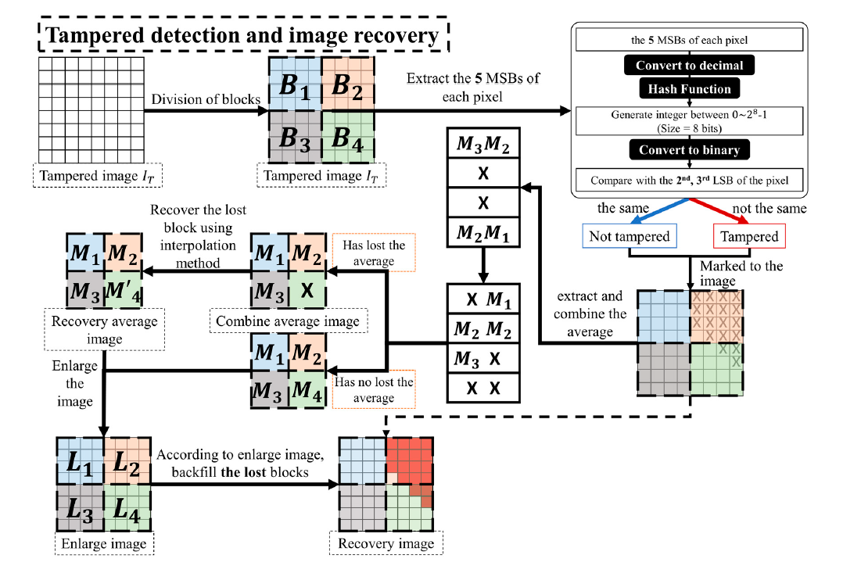
Tamper Detection and Recovery(pixel-wise)

